Slide 1



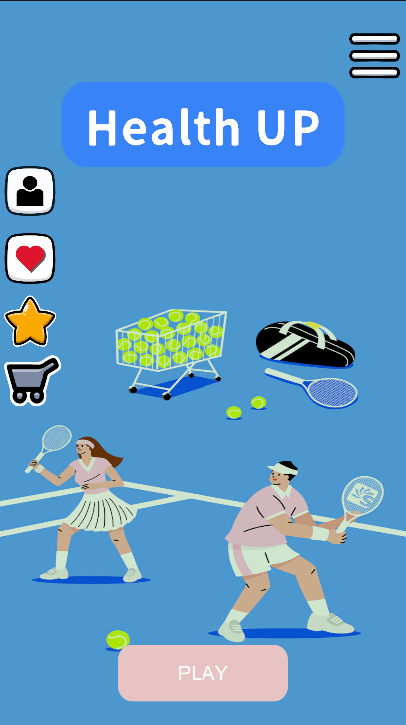

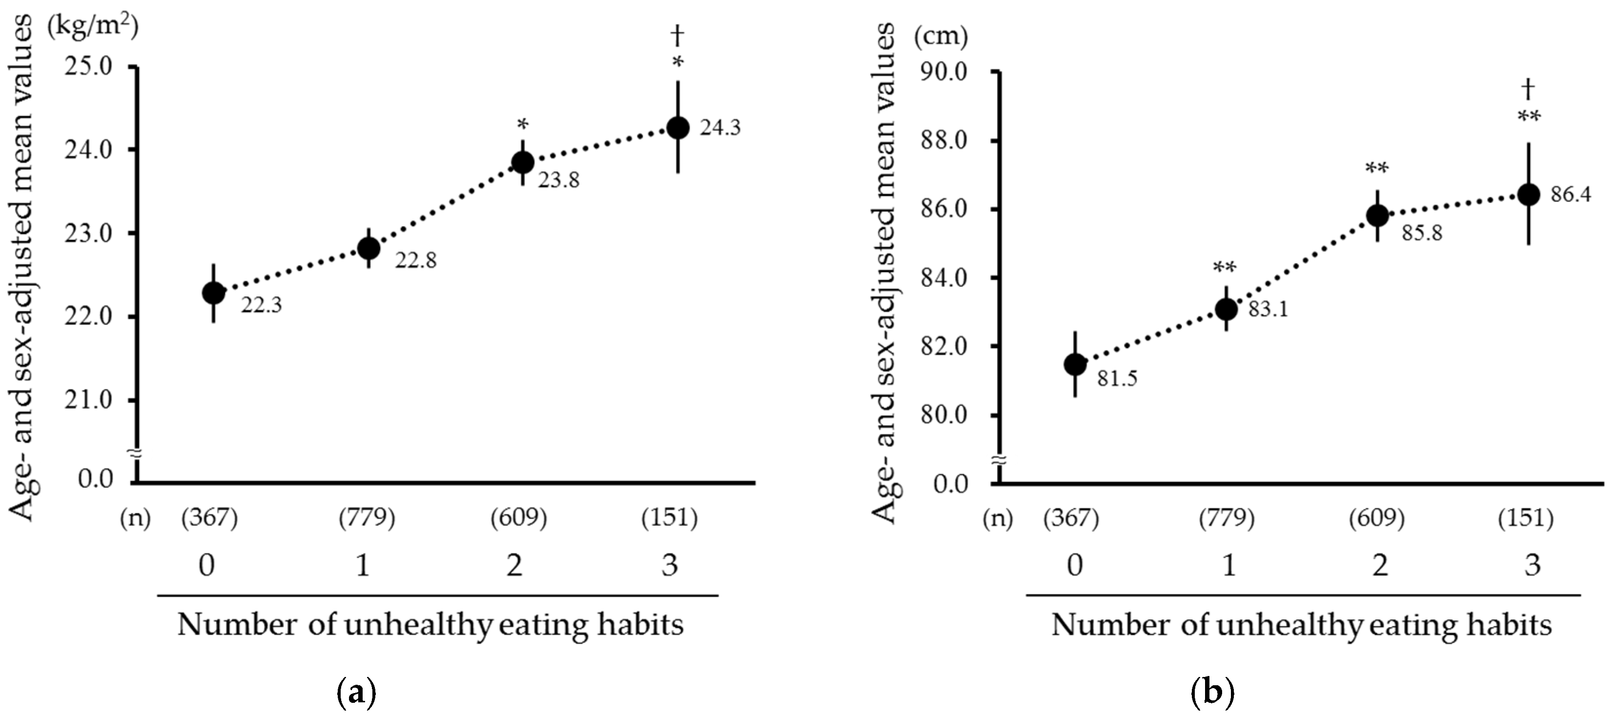
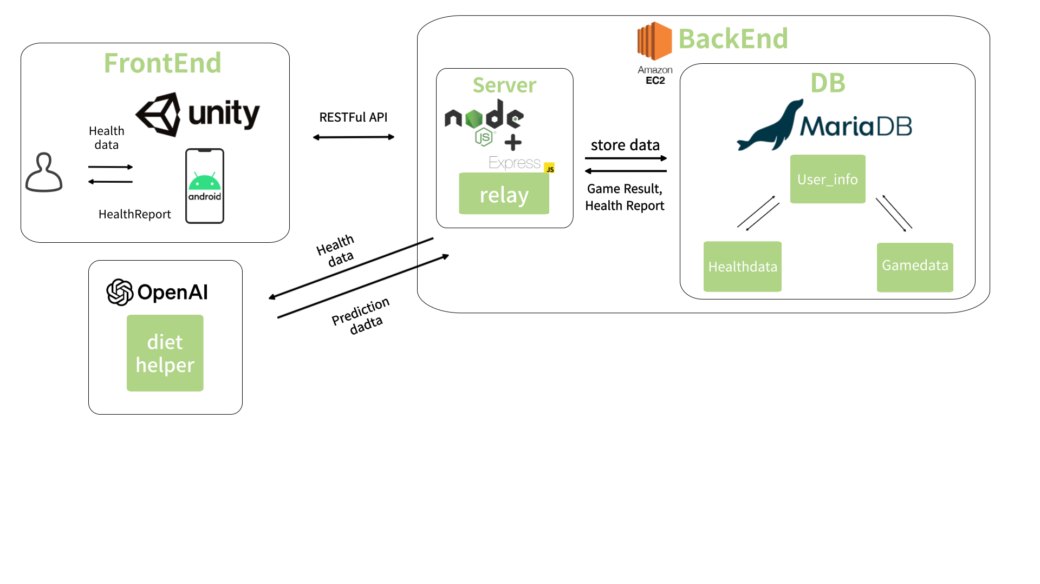

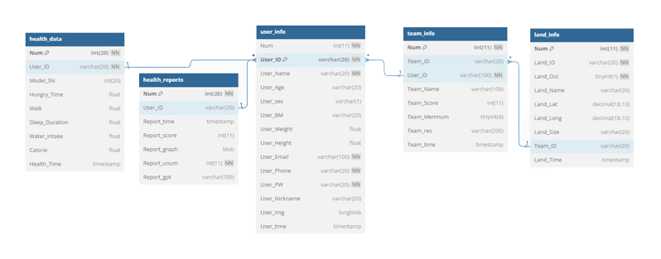
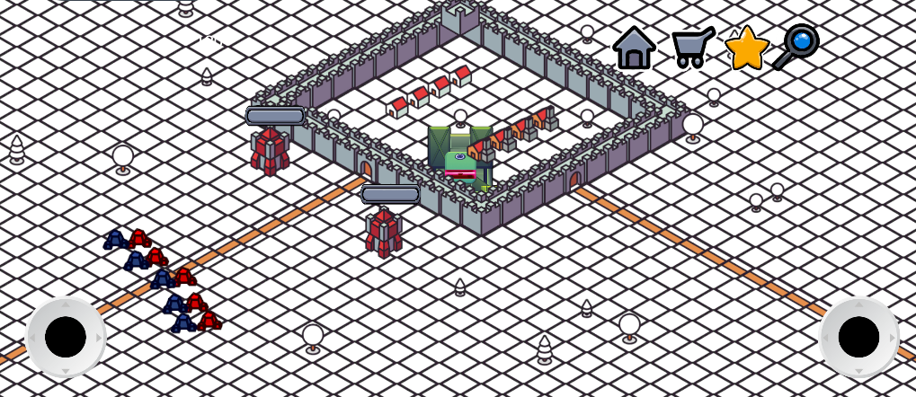
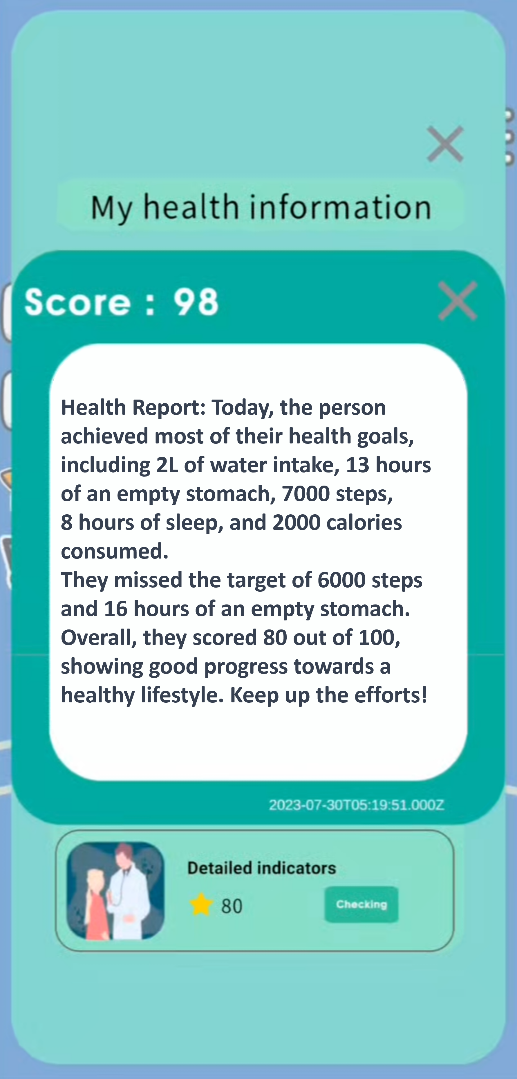
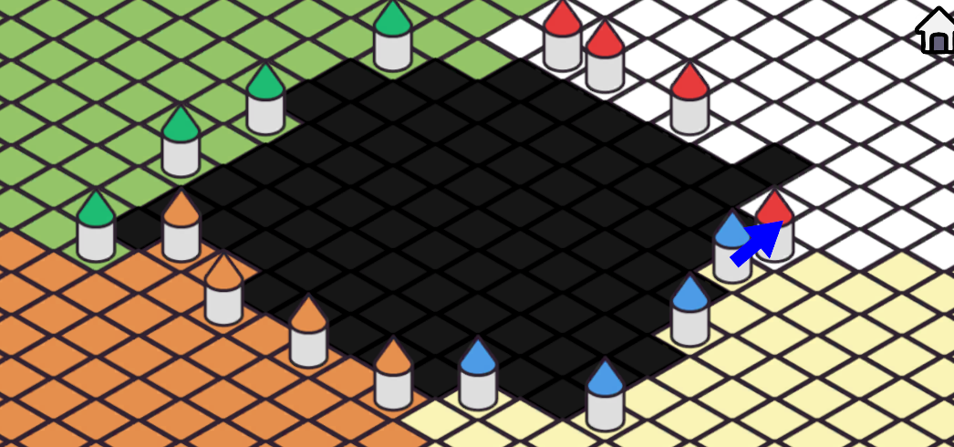





TO IMPROVE OBESITY BASED ON BIG DATA PERSONALIZED INTELLIGENT COOPERATIVE GAME
Team: i++
Author: Yunhee Kim¹, Seonghyun Roh¹, Jiwoong Choi², and Yeeun Kim³
Chungbuk National University¹
Dongseo University²
Sookmyung Women's University³
Advisor: JunHwan Jang, ChangCho Lawfirm
1. OVERVIEW & BACKGROUND
Are you familiar with the disease called obesity?
WHO defines doesity as:
“A condition in which there is an abnormal or excessive accumulation of fat in adipose
tissue to the extent that it is detrimental to health.”
Obesity is the cause of various adult diseased, so treatment and prevention are essential.
2. IMPORTANCE
Unhealthy habits and obesity rates are proportional to each other.
However, improving one’s lifestyle alone is not fun and it is difficult to have a sense of goal. Thus, we created a cooperative functional game that can be improved with a healthy lifestyle.
Our game achieves daily goals through games with many people.
Our functional game can be used anywhere as long as you install the application.
3. SYSTEM ARCHITECTURE
We built the server with Node.js Express and used Maria DB to store user data.
To get user data into unity and store it in the DB, we connected the server and unity
with a restful API.
We utilized the ChatGPT 3.5-turbo model to analyze health information
based on the user's data to provide scores and reports.
The game consists of a total of five tables.
These tables are designed to maintain referential integrity between tables
by referencing the 'user_Id' in the 'user_info' table.
We have configured the event scheduler and procedures
to automatically update data within the DB.
4. IMPLEMENT RESULTS
Let me introduce our two main features.
The first is to analyze your daily health data and provide you with a score and report.
Each day, the user enters their sleep duration, fasting time, water intake, calorie intake, and step count.
Using these five factors, a health score is calculated based on the weight of each compared to the user's daily goal.
Through prompt engineering, we get the health report from GPT and present it to the user along with the health score.
The second feature is a team-based siege game.
The team game consists of four teams, each with a total of four players.
Each team is given their own territory.
The game lasts for two weeks and is based on the health score of each team member.
The more team members on each team achieve their goals, the more territory they get.
The team with the most territory wins.
5. FUTURE WORKS
6. CONCLUSION
• The function of automatically saving my exercise information to DB in conjunction with a smartwatch
• Create an AI model through real-time health information
• Provide customized steps with trained AI models
• Implementing a Ranking System
• Certain types of primary and secondary obesity can reduce obesity through exercise therapy, diet therapy, and behavioral therapy.
• You can achieve the pleasure of achieving your goals through competition and the sense of accomplishment gained through cooperation.
• Through competition and cooperation with others, it provides a tier that can entertain people and honor them in the game.

